Slide 1
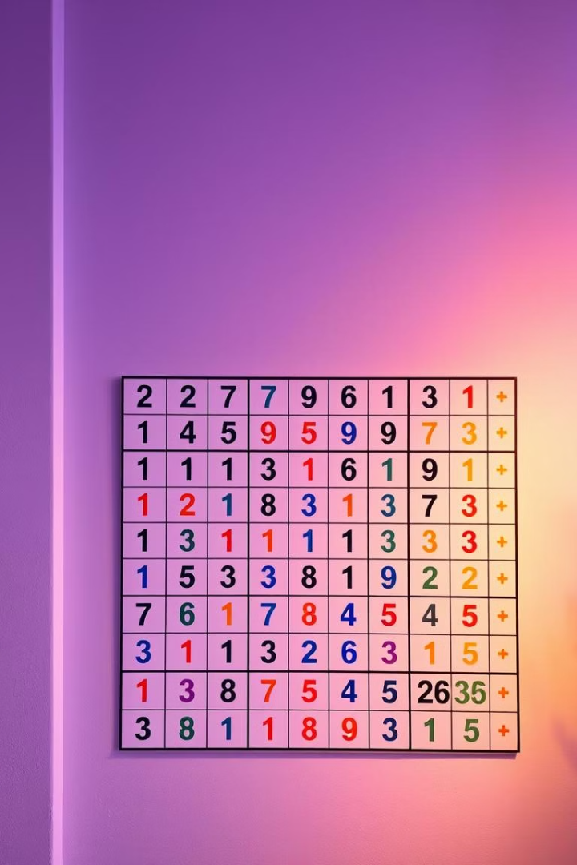

Sudoku Maker & Solver Project
Welcome to our presentation on the amazing world of Sudoku! In this project, we'll guide you through the step-by-step process of creating and solving these fun number puzzles.
Kl
by Kaisar ah lone

Slide 2
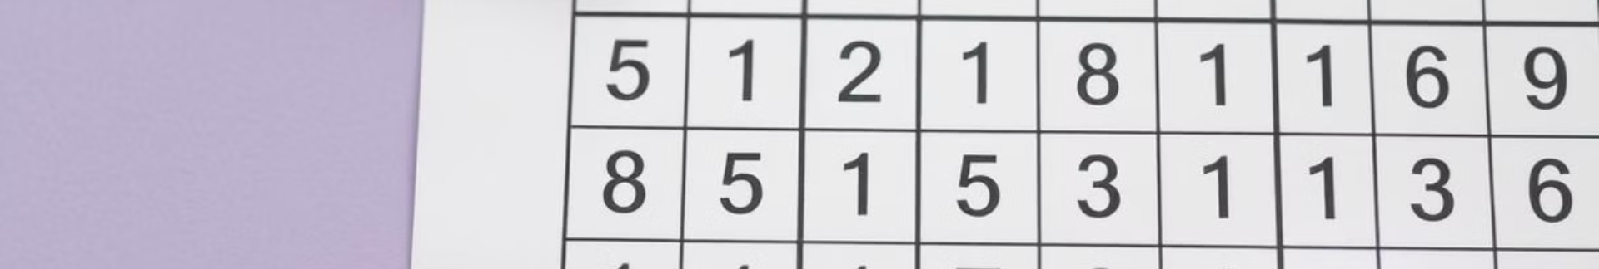
What is Sudoku?
Puzzle Game
Goal
Sudoku is a logic-based, number-placement puzzle game.
The objective is to fill a 9x9 grid with digits so that each column, each row, and each of the nine 3x3 subgrids contains all of the digits from 1 to 9.
Rules
Benefits
Every row, column, and 3x3 box must contain the digits 1 to 9 without repeating any numbers.
Sudoku helps improve critical thinking, problem-solving, and concentration skills, making it a fun and engaging activity for all ages.

Slide 3

Creating Sudoku Puzzles
Puzzle Generation
Verification
The first step in creating a Sudoku puzzle is to generate a completely filled 9x9 grid with the numbers 1 to 9.
Finally, we verify that the puzzle has a unique solution and meets the Sudoku rules before presenting it to the player.
1
2
3
Difficulty Adjustment
Once the grid is complete, we remove numbers strategically to create a solvable puzzle with the desired difficulty level.

Slide 4

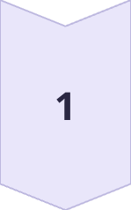
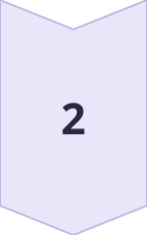
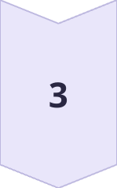
Solving Sudoku Puzzles
Analyze Grid
Carefully examine the given Sudoku grid to identify the available numbers and empty cells.
Apply Logic
Use logical reasoning to deduce the correct numbers that can be placed in the empty cells.
Validate Solution
Continuously check that the solution adheres to the Sudoku rules and constraints.

Slide 5
Sudoku Strategies
Elimination
Patterns
Pencil Marking
Identify the possible numbers that can be placed in each empty cell by eliminating the numbers already present in the same row, column, or 3x3 box.
Look for patterns and relationships between the numbers in the grid to uncover hidden information and make logical deductions.
Use a pencil to note the possible numbers that can be placed in each empty cell, making it easier to keep track of the available options.

Slide 6
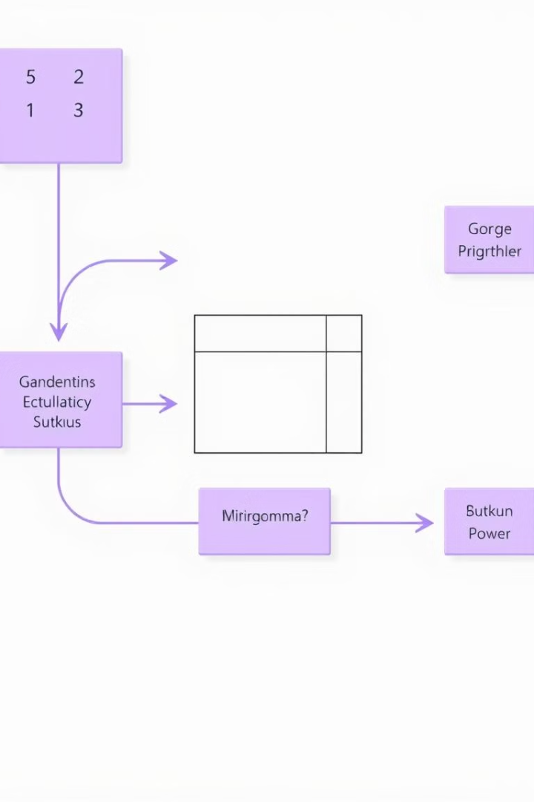
Sudoku Solver Algorithm
1
Backtracking
2
Constraint Checking
The Sudoku solver algorithm uses a backtracking technique to systematically try different number placements and backtrack when a solution is not possible.
The algorithm checks the row, column, and 3x3 box constraints to ensure that the placed numbers do not violate the Sudoku rules.
3
Recursive Calls
The algorithm recursively calls itself to fill the empty cells, exploring all possible solutions until a valid one is found.

Slide 7
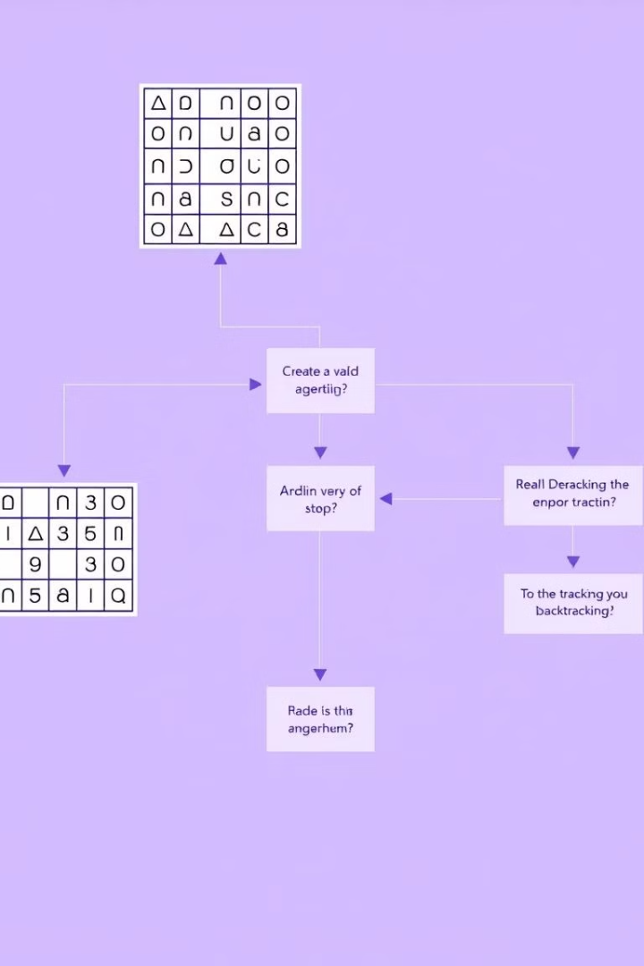



Sudoku Maker Algorithm
Puzzle Generation
The Sudoku maker algorithm generates a completely filled 9x9 grid with the numbers 1 to 9.
Difficulty Adjustment
The algorithm removes numbers strategically to create a solvable puzzle with the desired difficulty level.
Verification
The algorithm checks that the puzzle has a unique solution and meets the Sudoku rules.

Slide 8

Applications and Benefits
Cognitive Benefits
Sudoku helps improve critical thinking, problem-solving, and concentration skills.
Educational Use
Sudoku can be used in classrooms to teach logical reasoning and enhance mathematical skills.
Therapeutic Value
Solving Sudoku puzzles can have therapeutic benefits, such as reducing stress and improving mental well-being.
Entertainment
Sudoku is a fun and engaging activity enjoyed by people of all ages, making it a popular pastime worldwide.

Slide 9

Conclusion
1
Mastering Sudoku
2
Endless Possibilities
By understanding the creation and solving processes, you can become a true Sudoku master, enjoying the challenges and benefits of this captivating game.
The Sudoku Maker & Solver Project opens up a world of opportunities, from creating personalized puzzles to developing sophisticated algorithms for solving them.
3
Embracing the Challenge
Dive into the world of Sudoku and explore the fascinating interplay of logic, reasoning, and problem-solving. The journey is both rewarding and enjoyable.

Slide 10
THANK YOU

Slide 11


